Slide 2
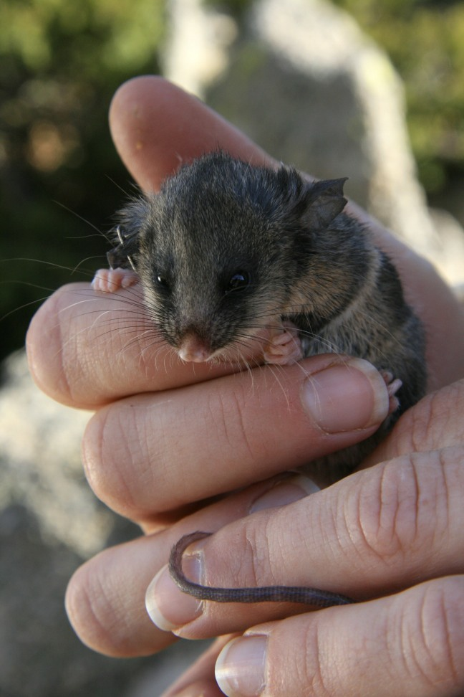
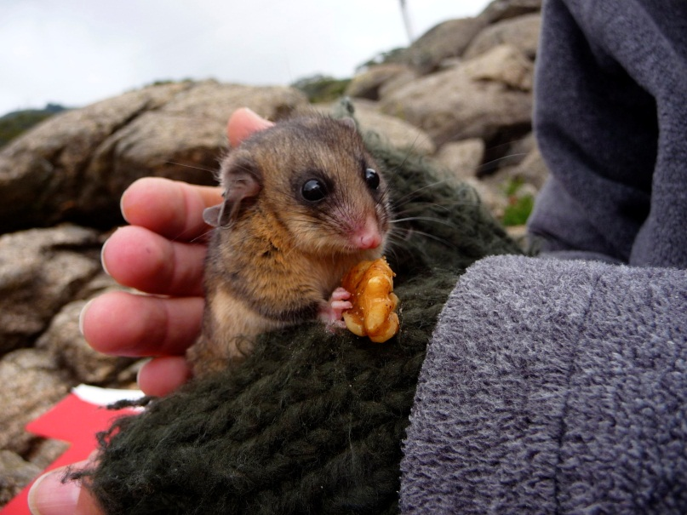
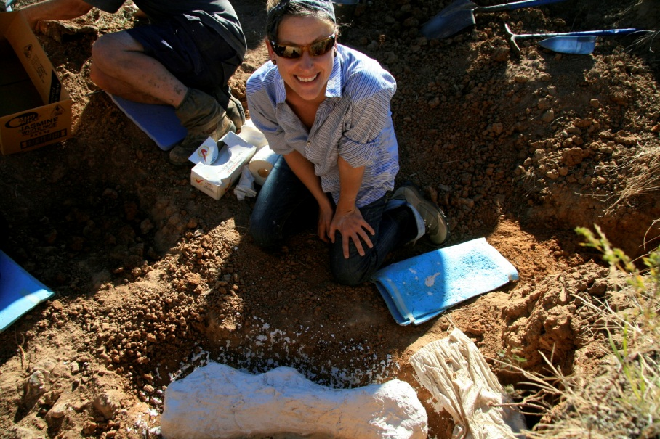
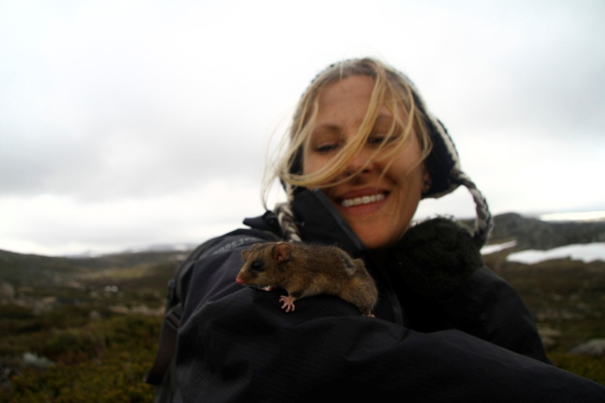
Education and Research
Bachelors in Psychology and Environmental Policy - USF
Masters in Conservation Biology – UNSW
Mountain Pygmy-Possums (Burramys parvus)
Translocation of a critically endangered species using the fossil record
National campaign – featured in Australian Geographic

Slide 3
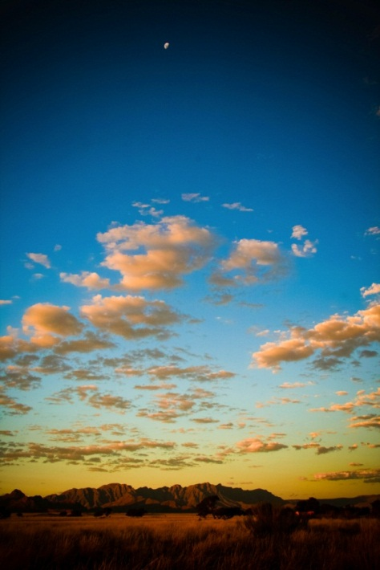
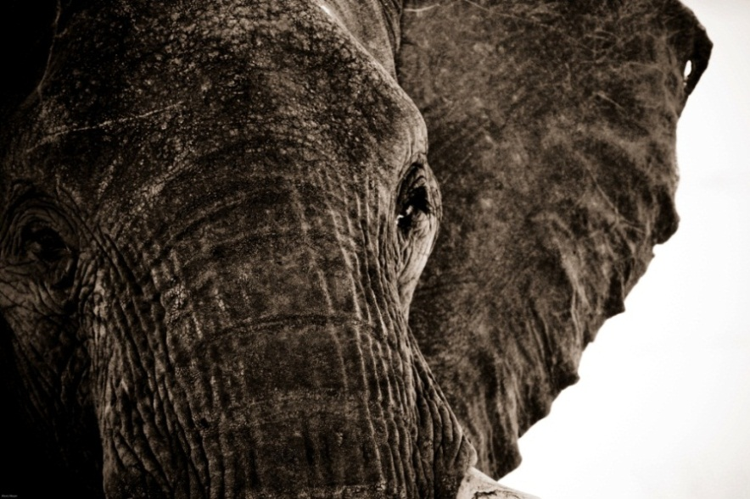
Work Experience
Adjunct Professor at University of Tampa
Environmental Science and Biology
Endangered Species Biologist for NOAA (NMFS)
Species of Concern Program Coordinator
Section 7 Consultant under the ESA
Employee of the Year
Nature Photographer

Slide 4
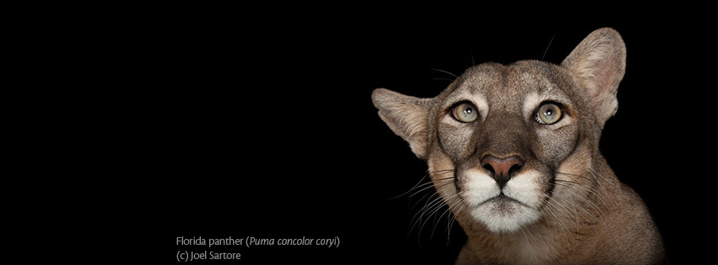
Florida Panther Critical Habitat Campaign
Alexis Meyer, MSc

Slide 5
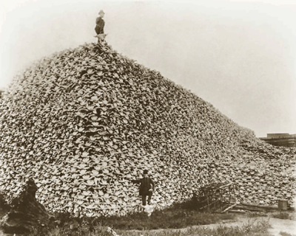
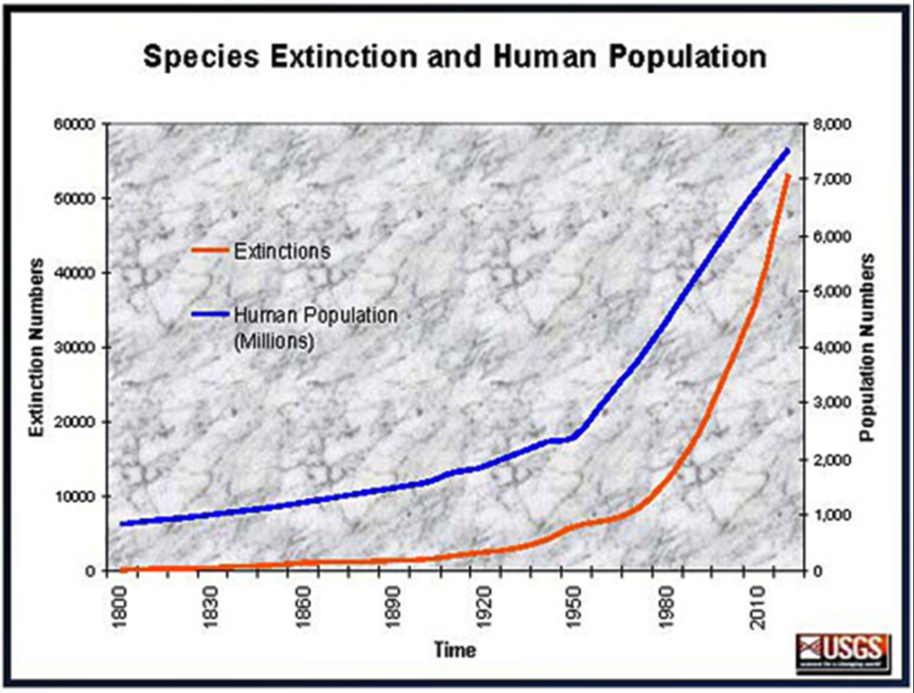
6th Mass Extinction Event

Slide 6
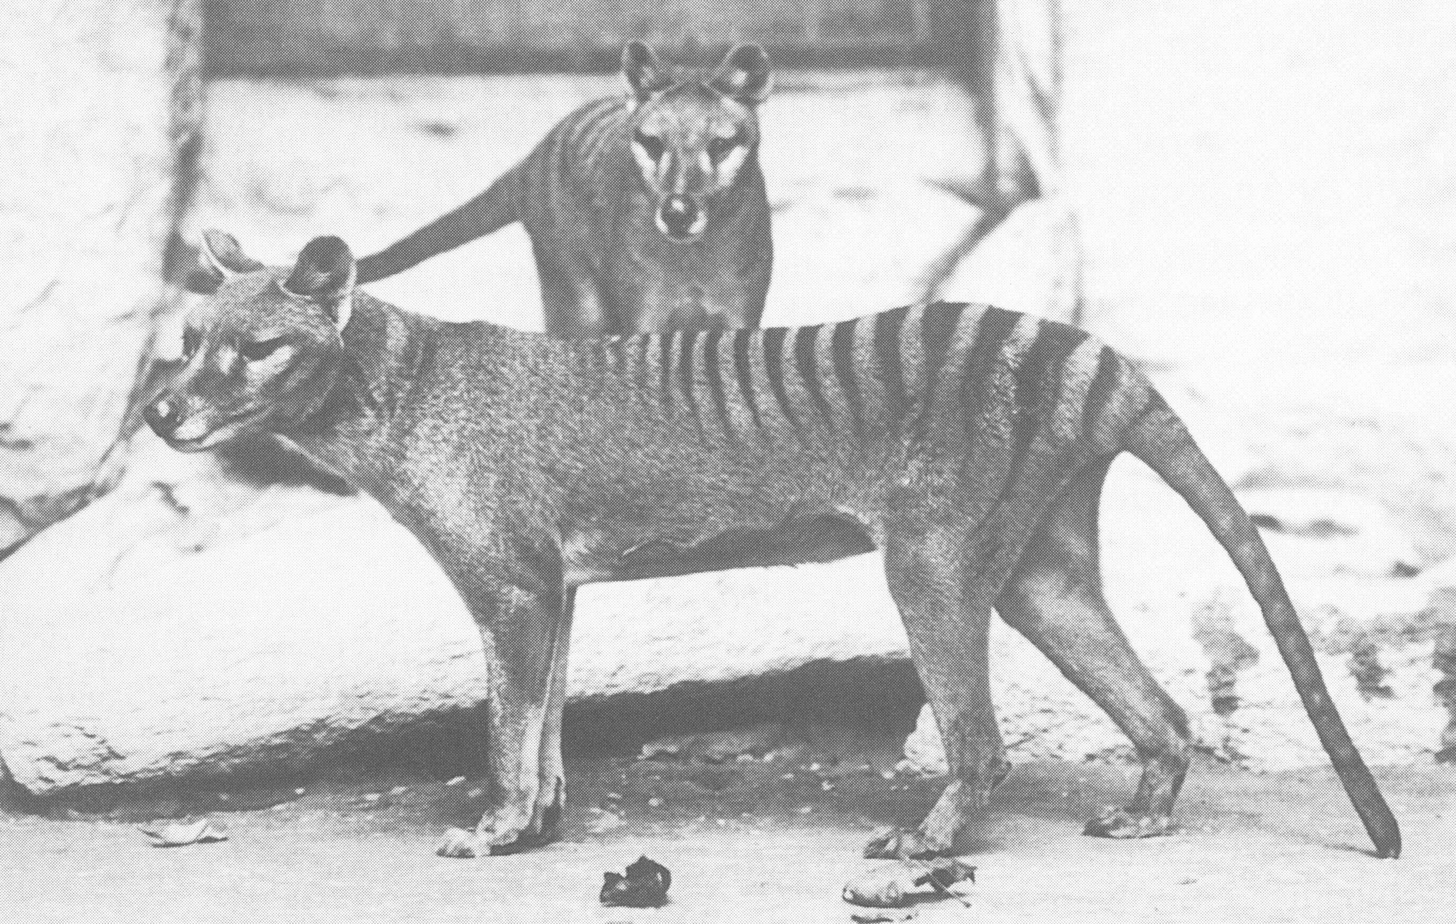
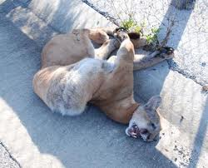
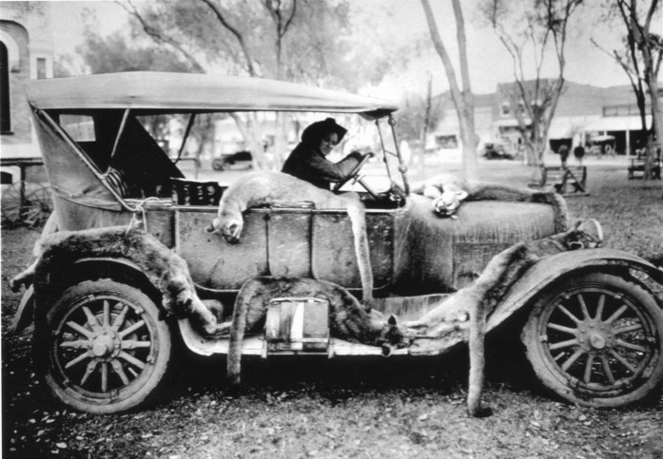
Watching a Species Vanish
Smithsonian Archives, FWC

Slide 7
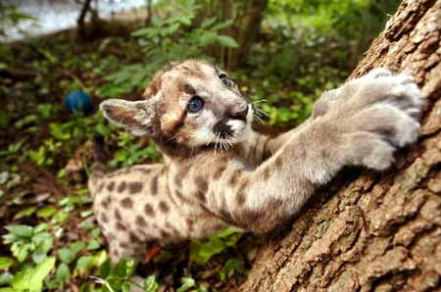
Life History
Puma concolor coryi
K-Selected Species
Live 5 -12 years
Have roughly 2 kittens
Tawny color
Weighing 100-160 lbs.
6-7 ft. long, 3ft. at shoulder
Nocturnal – most active at night
Feed primarily on hogs, deer, and small mammals
Home range of 75 miles (females) to 100 miles (males)
Depend on saw palmetto plant for dens and stalking prey
Shy – Have never attacked a human
Interesting Facts
Panthers can’t roar (but can purr)!
There are no black panther (only leopards, jaguars, and bobcats)
Lowry Park

Slide 8
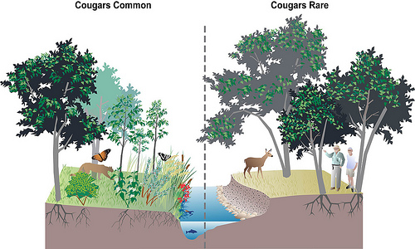
Why Florida Panthers?
Keystone Species
Represent the health of the ecosystem
Umbrella Species
Protects all species
Wyoming WRI
Charismatic Mega-fauna vs.
Imperiled Rarities
Ripple and Bescht (2006)

Slide 9
Historic Range
There is no "magic number" for saving species, but "if we can remove the negative effects of human activities, even relatively small populations could be viable in the long term.”
–Durham University
News-press.net

Slide 10
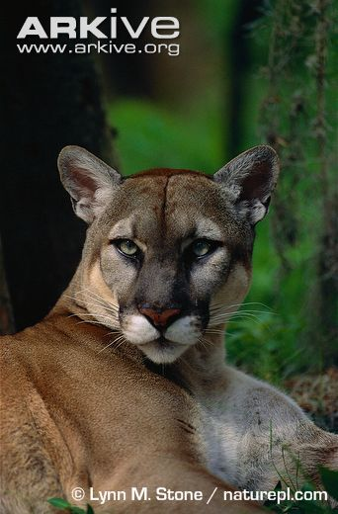
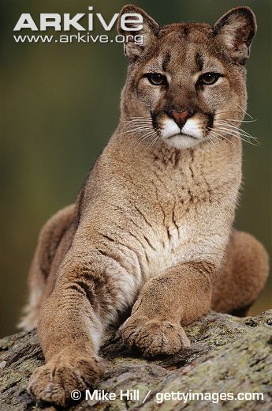
Mountain Lion vs. Florida Panther
And what about Texas cougars?
1995-2003

Slide 11
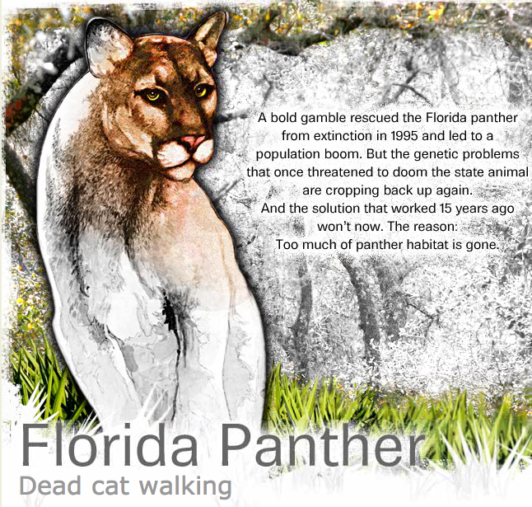

Slide 12
Florida Panther Organizations
Sierra Club
The Conservancy of Southwest Florida
Defenders of Wildlife
Audubon Florida
Florida Panther Society, Inc.
Friends of the Florida panther Refuge
Panther Net (FWCC)
Florida Panther Protection Program
South Florida Wildlands Association
Wildlife Foundation of Florida
Florida Wildlife Federation

Slide 13
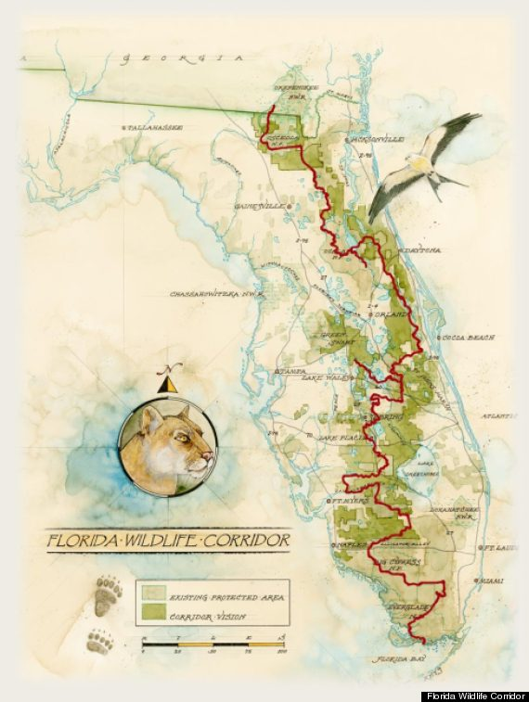
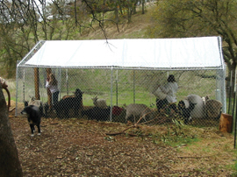
Florida Panther Programs
Cattle Compensation Program
Cooperative Conservation Blueprint
Eastern Collier Multi-Species Habitat Conservation Plan (HCP)
Rural Land Stewardship Area program
Florida Wildlife Corridor Expedition
Panther Posse (FGCU)
Florida Water and Land Legacy

Slide 14
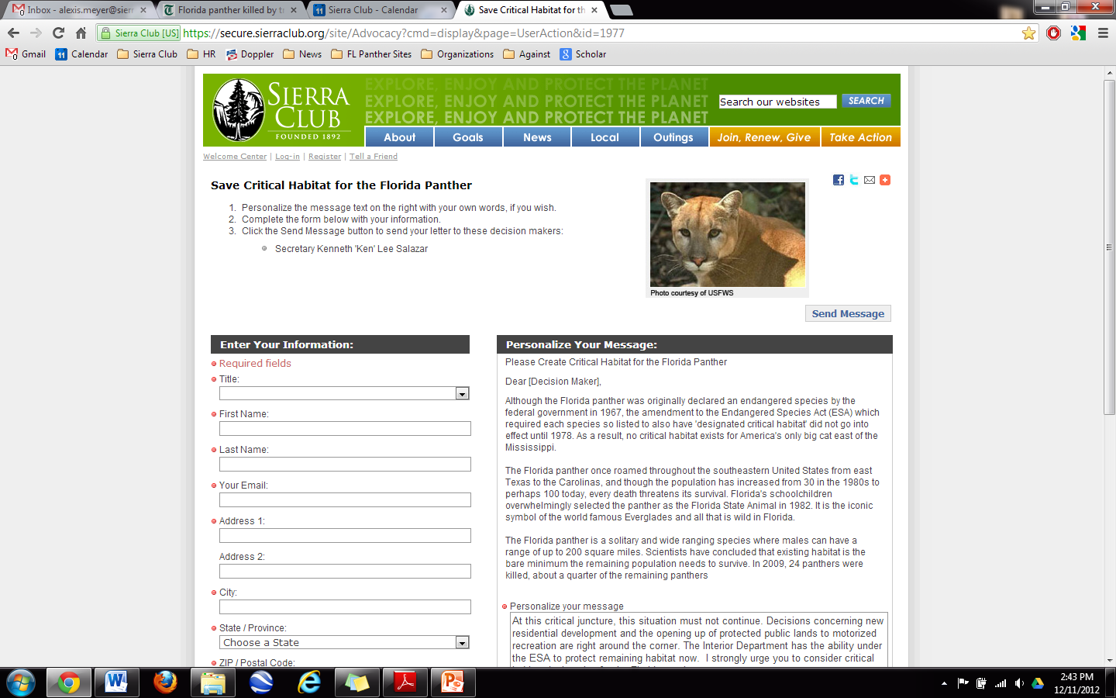
What has Sierra Club done in the past?
Petition to list Critical Habitat Designation
Sued FWS in 2010
Designation denied in 2012
Litigation
Bear Island: Won!
Big Cypress Addition Lands: Won!
Babcock Ranch Settlement Agreement: Won!

Slide 15
What is Critical Habitat?
The legal definition
“A specific geographic area that contains features essential for the conservation of a threatened or endangered species and that may require special management and protection. Critical habitat may include an area that is not currently occupied by the species but that will be needed for its recovery.” – Fish and Wildlife Service
How it impacts panther conservation
Would require the consideration of cumulative effects from proposed projects
Loop-holes in the ESA
Panther listed in 1967
ESA created in 1973

Slide 17
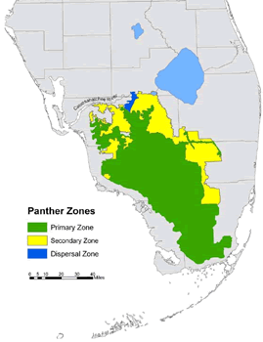
Protect Imperiled Lands
Primary Habitat Zone
Secondary Zone
Dispersal Zone

Slide 18
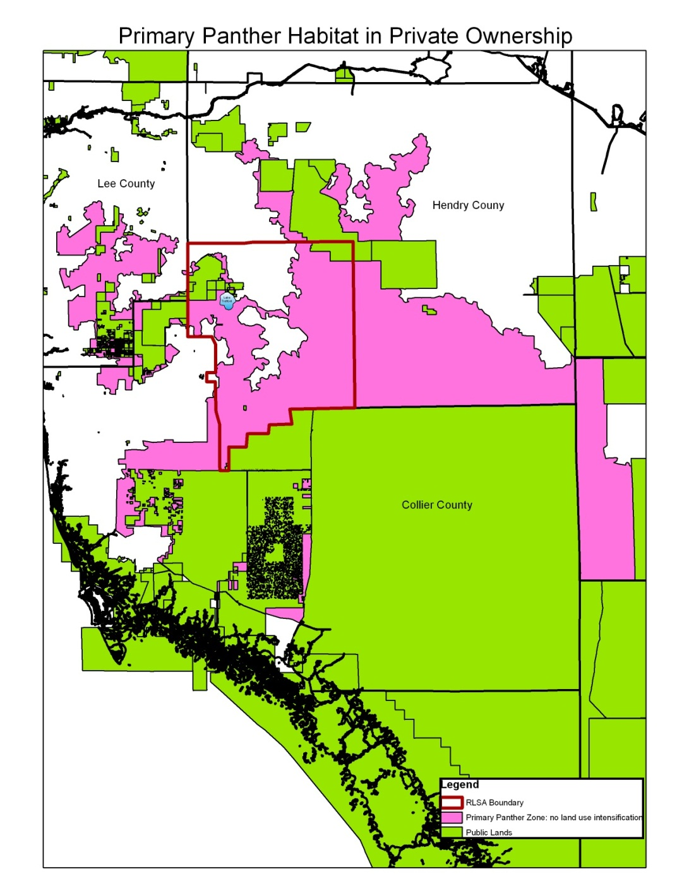
Land Acquisition
Florida Forever
Florida Water and Land Legacy
Everglades Headwaters National Wildlife Refuge
Florida Panther National Wildlife Refuge
Fisheating Creek National Wildlife Refuge

Slide 19
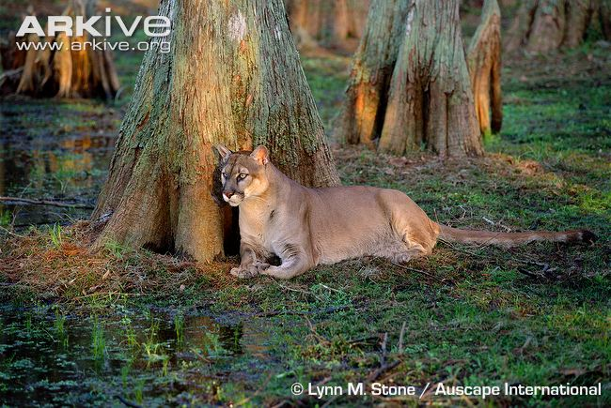
Prevent Harmful Development
Prevent urban sprawl, unnecessary roads, mines, etc.
Many current land management plans do not reflect the impacts of the economic crises
Conservation easements will help prevent urban sprawl
More roads mean more panther deaths
How do we want Florida represented?
As a concrete wasteland or something still a little wild?

Slide 20
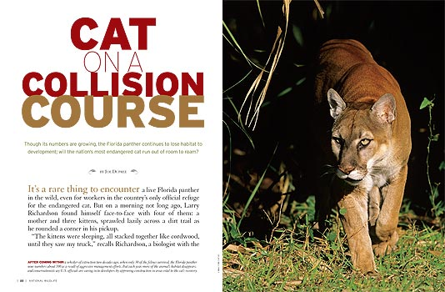
Educate
Build working relationships with agricultural and rural land owners
Work with students, from elementary to university
Presentations to raise panther awareness
Create a grassroots network impacting the future of Florida’s land use issues
NWF
FCGU

Slide 21
Deaths 2013

Slide 22
Deaths 5 Years (2009-2014)

Slide 23
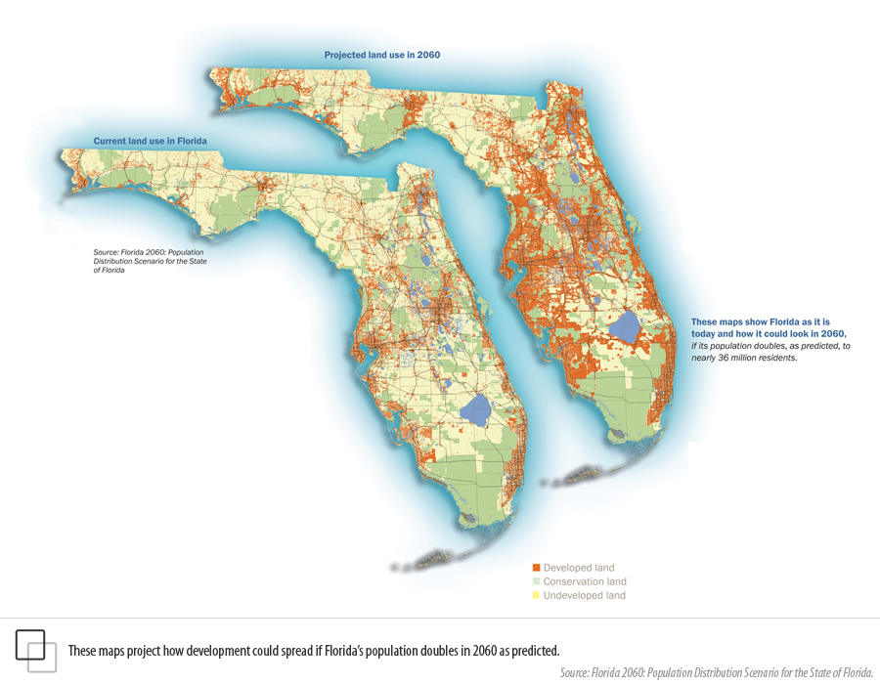

Slide 24
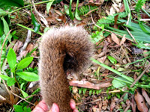
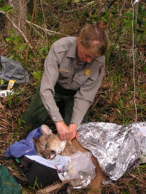
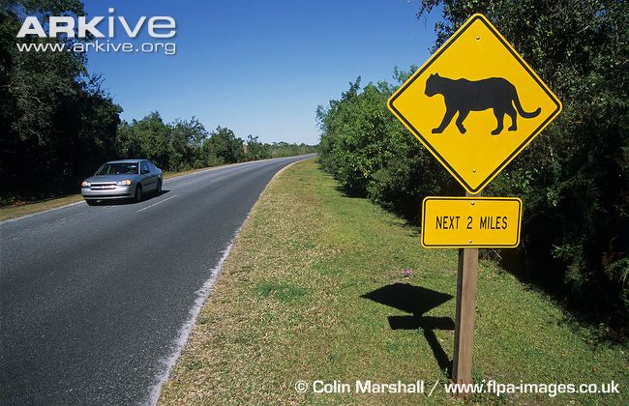
Do More Deaths mean More Panthers?
FWCC
Population estimates at 100-140
Starting to see inbreeding again
The root of the problem is lack of habitat
NPS

Slide 25
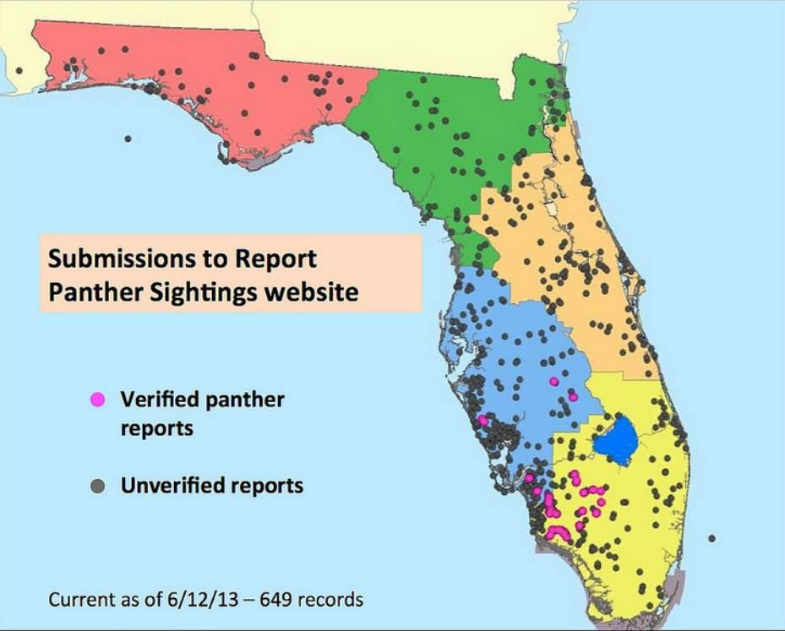
Panther Sightings

Slide 26
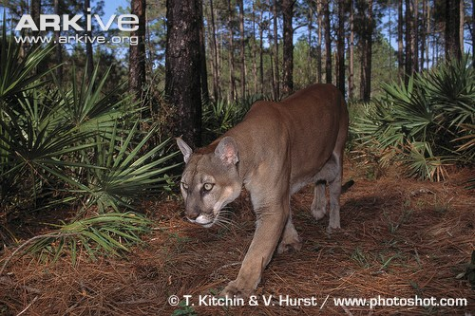
National Coverage of Big Cat Issues
Panthera
The Rewilding Institute
Cougar Rewilding Foundation
Felidae Conservation Fund
Mountain Lion Foundation
National Geographic
We want to make the Florida panther as recognizable as the Polar bear!

Slide 27
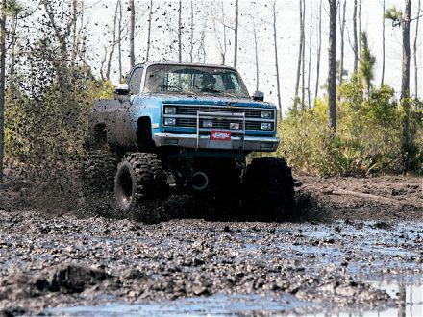
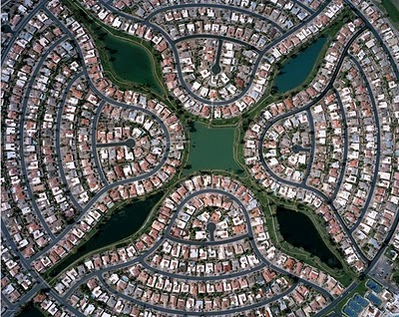
Highlights of 2013
I-75 Interchange
Rural Land Stewardship Area
Swamp Hammock Mud-bogging Park
Big Cypress Secondary ORV Trails Litigation
Hogan Island Quarry Litigation
Oil drilling in Collier

Slide 28
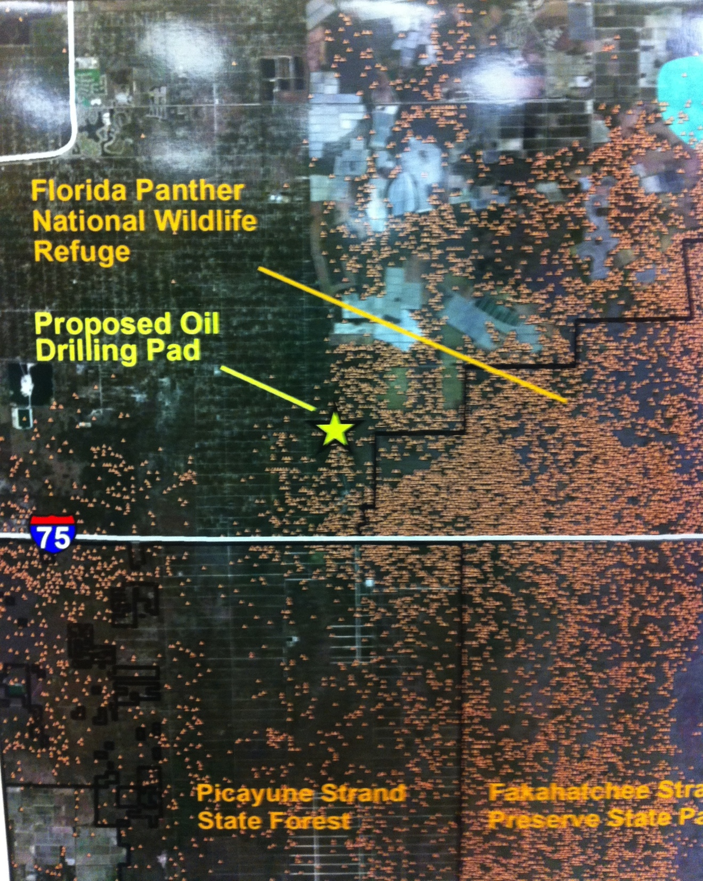
Goals for 2014
Florida Panther Symposium – March 21st, UF
Continue to fight exploratory wells in southwest Florida
List Edison Farms under Lee County’s Conservation 20/20 Program
Updates to the Florida Panther National Wildlife Refuge Comprehensive Conservation Plan

Slide 29
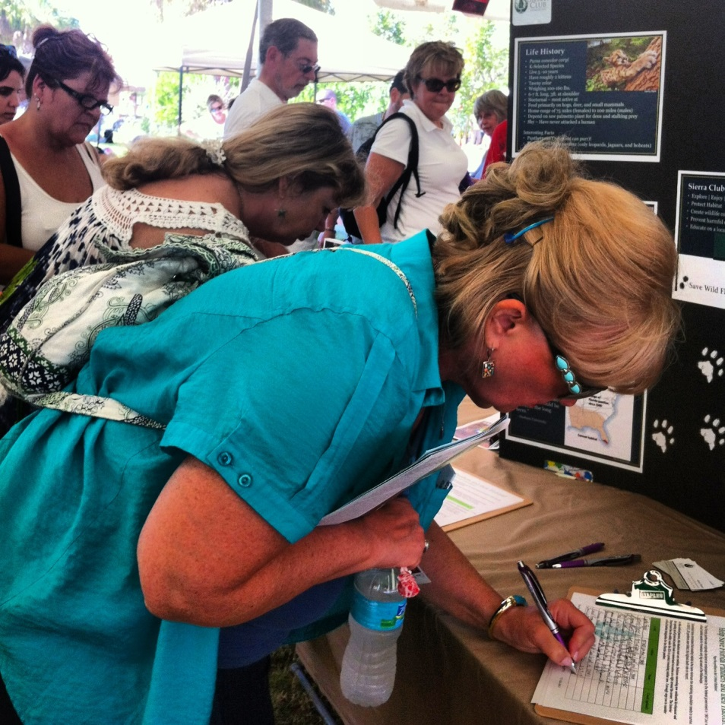
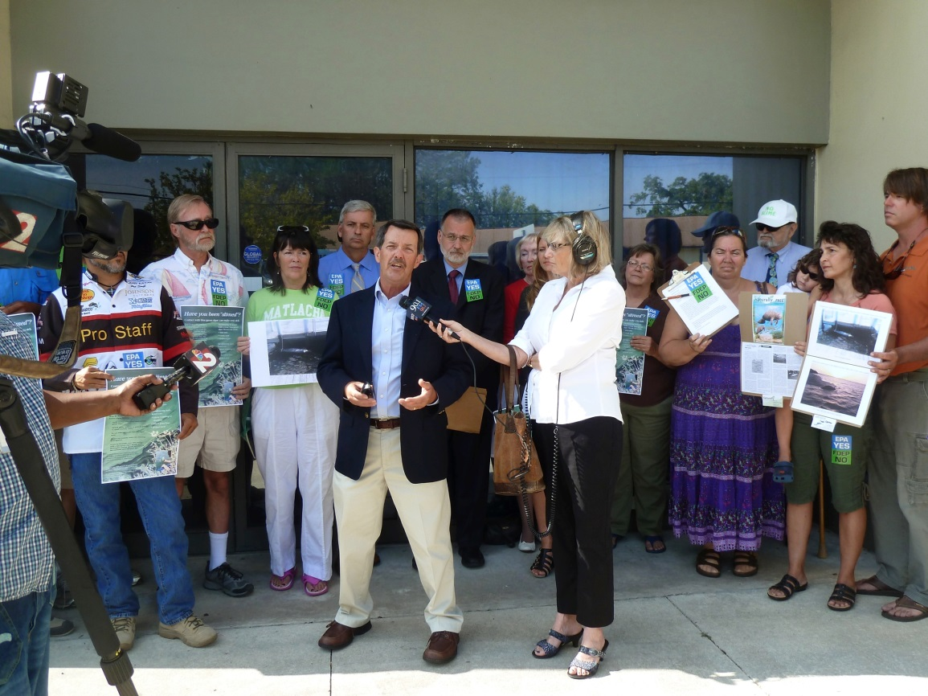
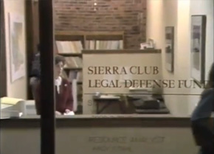
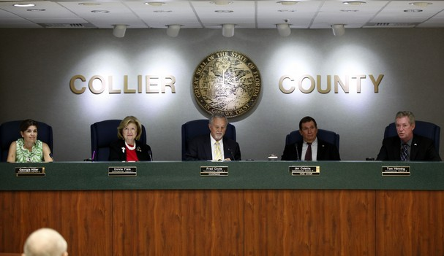
Taking Action!

Slide 30
The Future of the Campaign
Build Grassroots power and strong relationships
Protect critical linkages and lands
Go National!

Slide 31
How You Can Help!
Support Sierra Club
Show your support by coming to hearings and other events
Your voice really does make a difference!
Follow the Campaign
Website: http://florida.sierraclub.org/pantherhab1.asp
Facebook: www.facebook.com/FLPantherCampaign
Twitter: www.twitter.com/Save_FLPanthers
Educate others about panther habitat loss and species decline
Pressure local governments not to approve development in sensitive areas and support protection and acquisition of panther habitat
Demand Critical Habitat Designation
Drive carefully

Slide 32
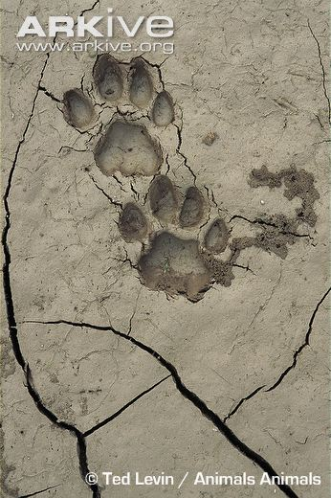
Florida Panther Team: Thank You!
Brian Paradise NE Florida Marti Daltry Calusa Ruth Bromberg Charlotte Harbor Marcia Biggs Tampa Bay Marian Ryan Ancient Islands Beverly Griffiths Tampa Bay Kent Bailey Tampa Bay Barbara Curtis Broward Roy Ault Manatee-Sarasota Paula House Ancient Islands

Slide 33
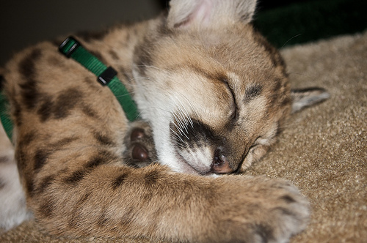
Thank You! Questions Welcome!
Flickriver.com

